Slide 1
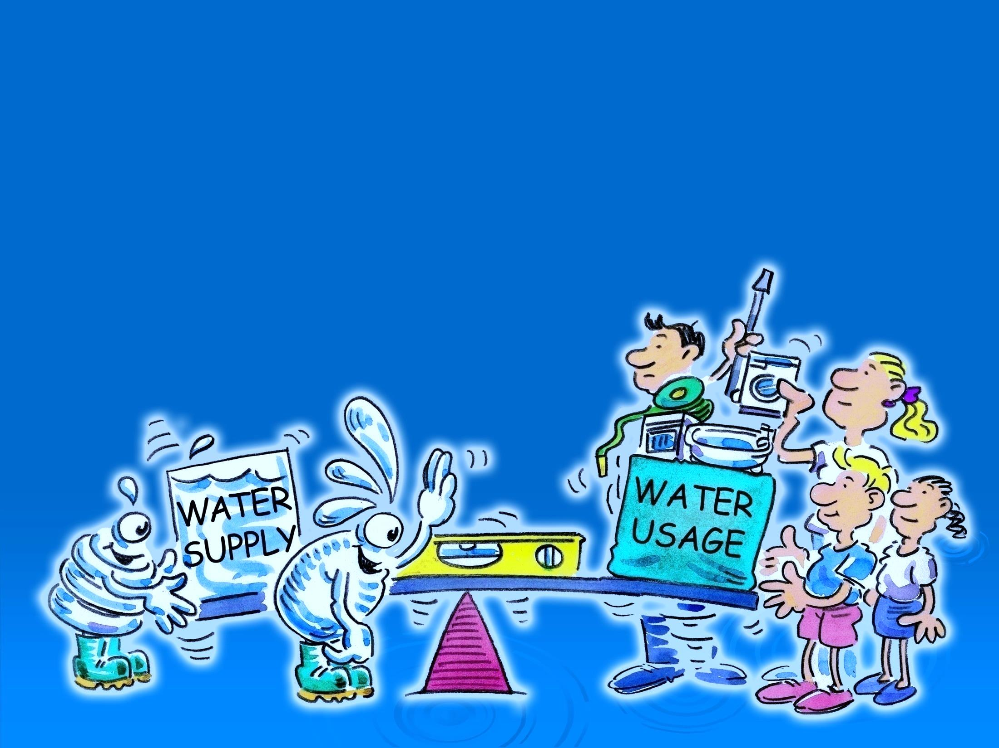

Saving Water Workshop

Slide 2


Slide 3


Slide 4
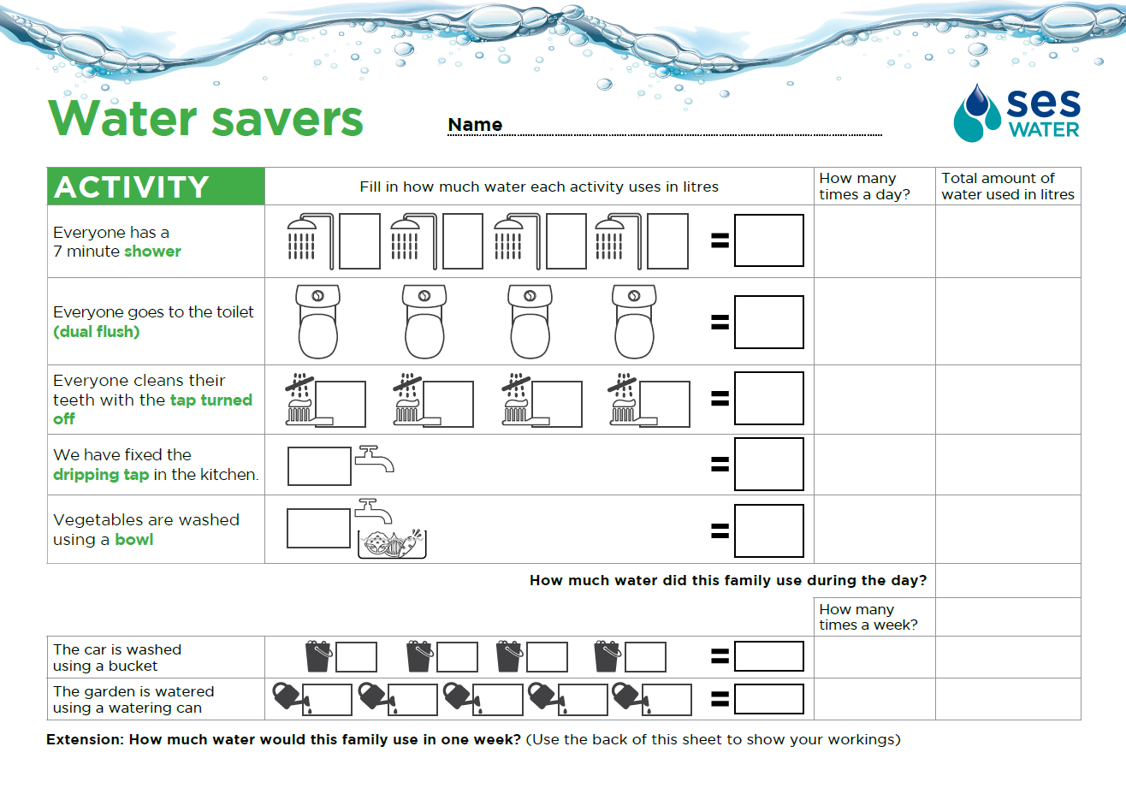
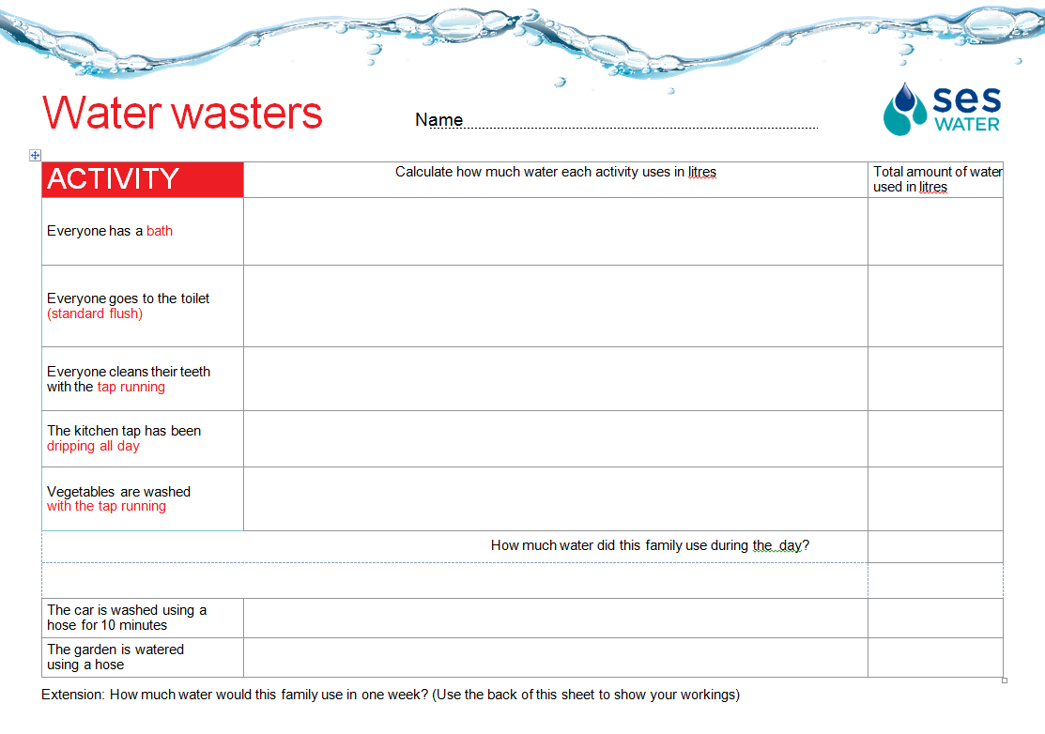

Slide 5
Water x People x Number of times a day

Slide 6

Activity | Calculations | Amount of water used each day
Bath
Shower
Toilet – standard flush
Toilet – dual flush
Teeth –leaving the tap running
Teeth –turning the tap off
Dripping tap
Dripping tap - repaired
Washing vegetables –tap running
Washing vegetables –in a bowl
Washing the car with a hose
Washing the car with a bucket
Watering the garden with a hose
Watering the garden with a can
100 x 4
400 litres
60 x 4
240 litres
8 x 4 =32 32 x 5 =
160 litres
6 x 4 =24 24 x 5 =
120 litres
10 x 4 = 40 40 x 2 =
80 litres
1 x 4 = 4 4 x 2 =
8 litres
15 x 1
15 litres
0
6 x 1
6 litres
4 x 1
4 litres
17 x 10
170 litres
8 x 4
32 litres
17 x 10= 170 170 x 3=
510 litres
6 x 5 = 30 30 x 3 =
90 litres

Slide 7

Activity | Wasters use | Savers use | Difference
Bath/shower | 400 litres | 240 litres
Cleaning teeth | 80 litres | 8 litres
Flushing the toilet | 160 litres | 120 litres
Dripping tap | 15 litres | 0 litres
Preparing vegetables | 6 litres | 4 litres
Total
160 litres
72 litres
40 litres
15 litres
2 litres
661 litres
372 litres
Altogether the amount of water that could be saved is
289 litres
Washing the car | 170 litres | 32litres | 138 litres
Watering the garden | 510 litres | 90 litres | 420 litres
Weekly use | (661 x7)+170+510 | (372 x7)+32+90
Total | 5,307 litres | 2,726 litres | 2,581 litres

Slide 8

